Slide 1
AD166 The Taking UI to the next level: Develop SAPUI5 with SAP Build
Tommy Vinh Lam, Senior Developer, SAP Christian Voshage, Product Manager, SAP
Oliver Graeff, Director - Product Management, SAP Christian Georgi, Development Manager, SAP
November 2025

Slide 2
What you will learn
Developing a freestyle SAPUI5 Web app using TypeScript
Integrating a UI5 Web Component into this SAPUI5 app
Using the UI5 linter to ensure your app follows the latest best practices
Leveraging Joule for SAPUI5 development

Slide 3


SAPUI5 development with SAP Build
Build where your business lives, in the context of your applications, data and AI.
SAP Build
Start quickly
with AI and pre-built solutions
Unified solution
Apps and extensions
Workflows and automations
AI agents
Digital workspaces
3x development efficiency
Deliver faster
with tools for every role
Pro-code and low-code
AI copilot
SAP proprietary models, contextual, partner ecosystem
Pre-built solutions
500+ finance, HCM, supply chain and beyond
Fully integrated
with SAP Business Suite and non-SAP applications
Apps
Data
Business AI
Notes:
Speaker Notes:
SAP Build is fully integrated with the SAP Business Suite, SAP Business Data Cloud, and SAP Business AI. It’s how you extend the suite — with tools that understand your business context, tap into trusted data, and plug directly into your end-to-end processes. This deep integration means every app, automation, or AI agent you build is ready to run at enterprise scale from day one.
Extension Layer SAP Build is your governed extension layer — enabling clean core development across apps, workflows, AI agents, and digital workspaces. Whether your teams are working code-first, low-code, or with embedded AI, they can build and ship up to 3x faster — without compromising standards or control.
Embedded AI Joule for developers brings generative AI directly into the build experience. It’s powered by SAP’s proprietary models and trained on real business logic — helping teams generate secure, contextual code and logic with speed and confidence.
Pre-built Content To accelerate time to value, SAP Build includes over 500 pre-built solutions spanning finance, HCM, supply chain, procurement, and more. These are enterprise-ready templates from SAP and partners — designed to be adapted, not started from scratch.
SAP Build is part of the SAP Business Technology Platform, which enables even the most complex organizations to create a fully integrated, agile foundation for developing data-driven solutions and meaningfully scaling AI.

Slide 4
SAPUI5 is SAP’s standard UI framework of choice
Consistent UX
Use anywhere
Enterprise UI elements
SAPUI5 enables the SAP Fiori design evolution across SAP solutions (and beyond).
SAPUI5 allows single, responsive app implementations for all browsers, platforms, and devices.
and UI integration cards to build professional UIs, SAP Web Components to cover all Web technology stacks.
Flexible tools
Innovations
Powerful extensibility
for any developer: SAPUI5 comes with tools to efficiently build, test, and deploy apps, including SAP Build Code.
SAPUI5 brings a clear separation of apps and framework to centrally innovate while staying upgrade-compatible.
Customers/partners can adapt SAP standard apps and customize UIs with/without coding.

Slide 5

TypeScript = JavaScript + Types
var someNumber: number;
var otherNumber = 1;
function square(x: number) {
return x * x;
}
type Point = {
x: number;
y: number;
};
Benefits
Code completion
Error messages while you code
In-place API reference
Easier refactoring and maintenance

Slide 6
A Consistent and Seamless UX across SAP's products
HTML
Angular
React
SAPUI5 (incl. SAP Fiori elements)
Programming Model
Angular UI comp.
React UI comp.
SAPUI5 controls
SAP Web Components
UI elements

Slide 7
A Consistent and Seamless UX across SAP's products
HTML
Angular
React
SAPUI5 (incl. SAP Fiori elements)
Programming Model
Angular UI comp.
React UI comp.
SAPUI5 controls
SAP Web Components
UI elements

Slide 8






SAPUI5 Best Practices: Static code analysis with UI5 linter
UI5 linter in Action
UI5 linter is a static code analysis tool for UI5 application code
UI5 linter scans your UI5 code (JavaScript, TypeScript, XML, JSON, and other files) for:
Usage of deprecated libraries
Usage of deprecated framework APIs
Usage of global variables
Possible CSP violations
Deprecated component and manifest configurations
Autofix option can automatically correct certain findings
UI5 linter validates your SAPUI5 code against UI5 best practices​
Ensure your code is ready for upcoming SAPUI5 versions

Slide 9
Seamless Integration of SAP Web Components into SAPUI5
SAPUI5 app
<SAPUI5 control>
<SAPUI5 control>
<SAPUI5 control>
<SAPUI5 control >
<SAPUI5 control>
SAP Web Component
<SAPUI5 control>

Slide 10

Seamless Integration of SAP Web Components into SAPUI5
SAPUI5 app
<SAPUI5 control>
How you do it
Use SAP Web Components in SAPUI5 apps.
Consume just like regular SAPUI5 controls.
<SAPUI5 control>
<SAPUI5 control>
<SAPUI5 control >
SAP Web Component
Why you do it
SAP Web Components are strategic UI elements for ALL technology stacks.
Benefit from SAPUI5 framework features for SAP Web Components.
<SAPUI5 control>
<SAPUI5 control>

Slide 11

AD166 - Taking UI to the next level: Develop SAPUI5 with SAP Build
Exercise: https://github.com/SAP-samples/teched2025-AD166
User: AD166-001@education.cloud.sap … AD166-040@education.cloud.sap
Password: Acce$$teched25

Slide 12
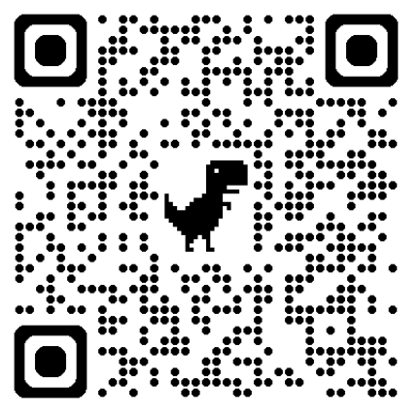
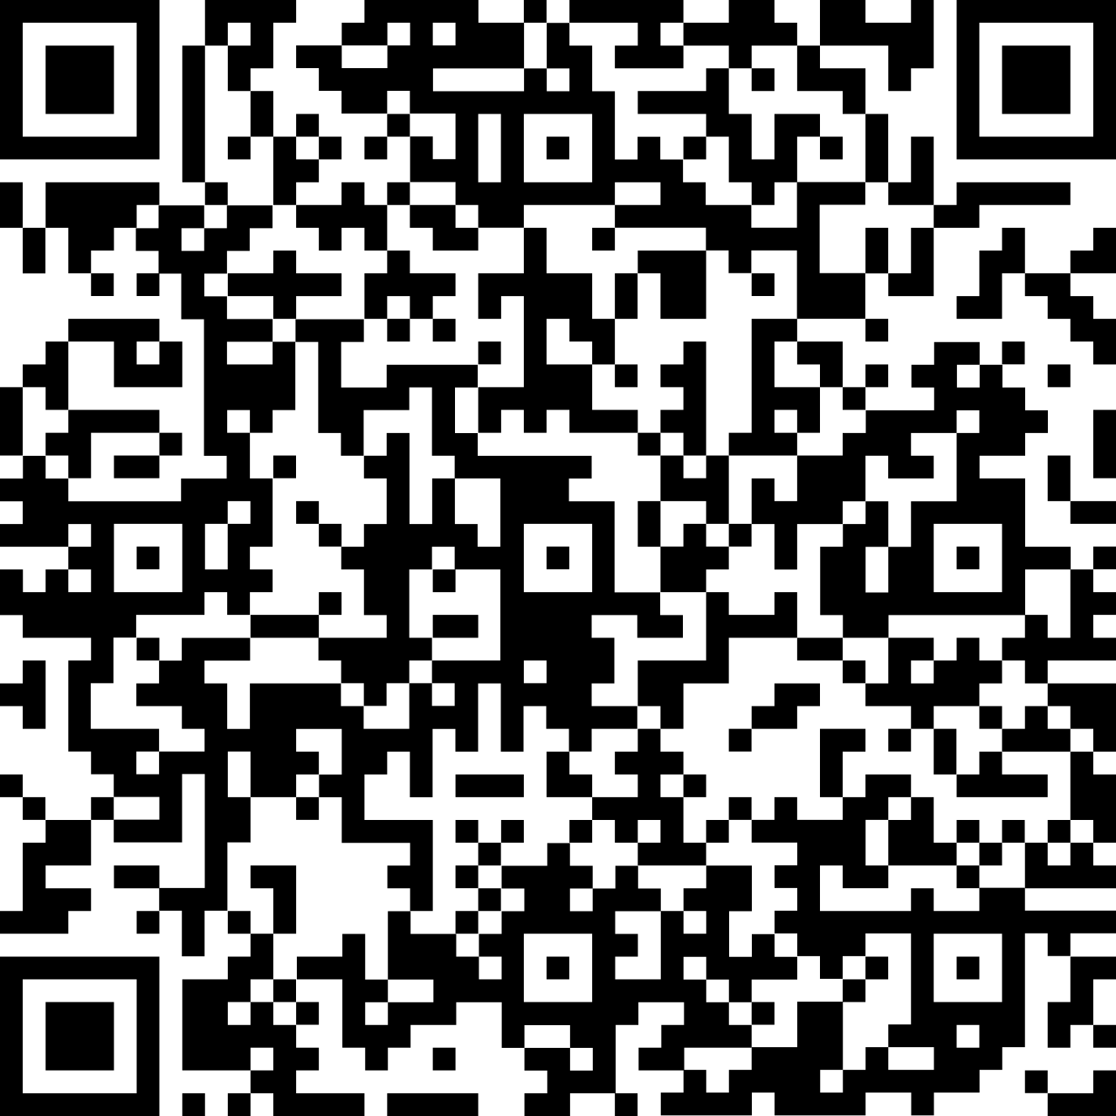

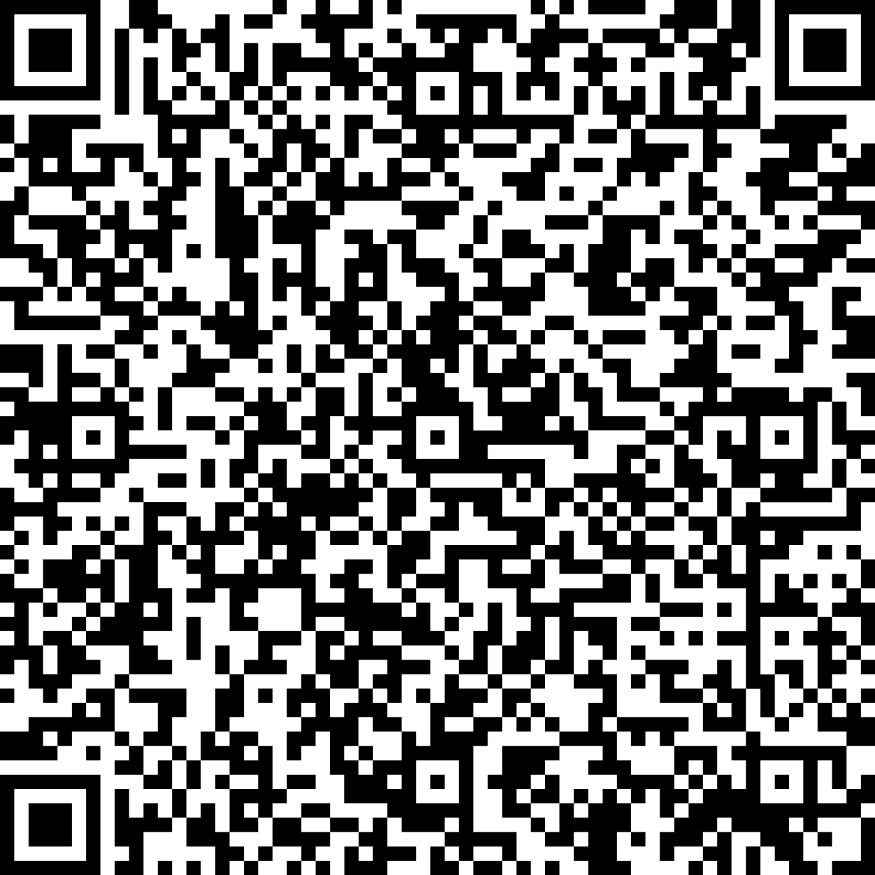



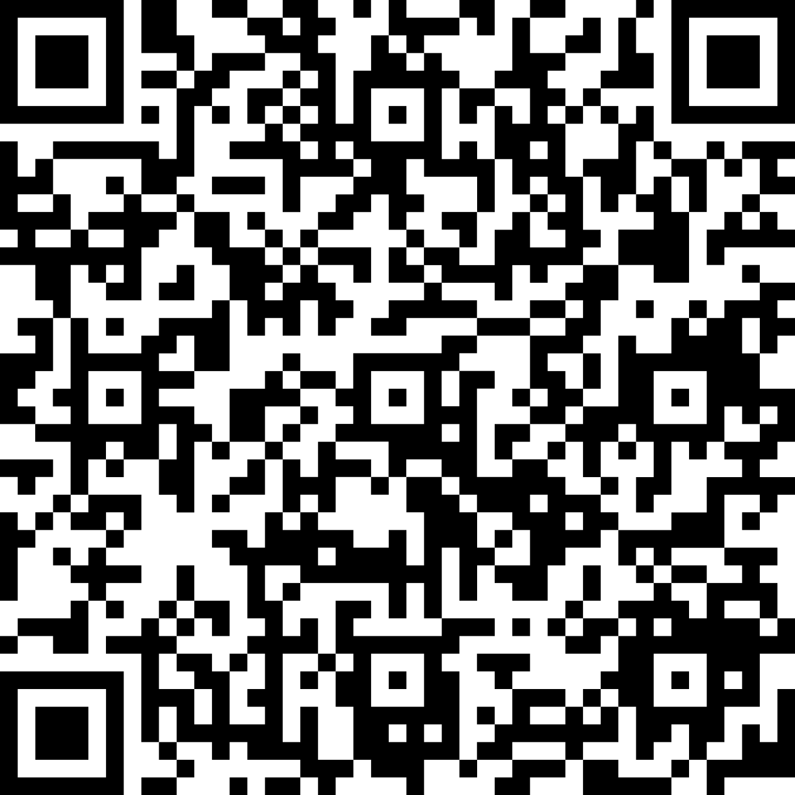

Begin your extension journey today with SAP Build
Get started at no cost
Start your free trial of SAP Build now
Activate your Build entitlements included in your RISE for SAP offering
Learn more
Visit SAP Build for S/4HANA Page
Try the SAP Build Learning journey
Accelerate development
Explore pre-built content for SAP S/4HANA Cloud from the SAP Build Store
Check out activation services available to help you get setup

Slide 13

The Art and Science of SAPUI5
1
SAP Fiori, SAPUI5, SAP Fiori elements
SAP Fiori Design Guidelines
What is SAPUI5?
https://ui5.sap.com/
Flexible Programming Model
SAPUI5 Best Practices
SAPUI5 MCP Server
SAP Web Components
2
Clean Core Extensibility
SAP BTP Extension Architecture Guide
SAPUI5 flexibility
Extension project vs. Adaptation project
Key User Adaptation Tutorial
Easy Key User Adaptation
Developer Adaptation Tutorial
3
SAP Business Technology Platform
SAP BTP
SAP BTP Guidance Framework
SAP Build
SAP Build Code and Product Updates
4
SAP TechEd
AD106v | The art and science of SAPUI5
Notes:
[Click]

Slide 14
tommy.vinh.lam@sap.com christian.voshage@sap.com
oliver.graeff@sap.com christian.georgi@sap.com

